Slide 1
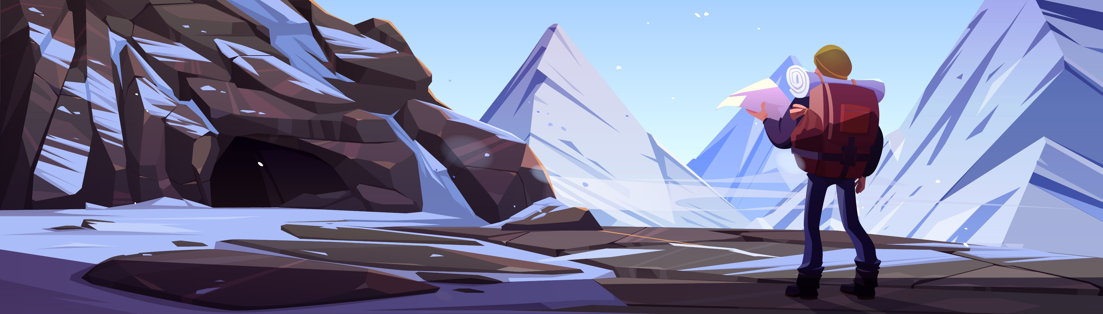






START
28426
677
Music Library
Character
Store
Stats
Health 100 Damage 10 Movement speed 8 Armor 14 Reload speed 2 seconds ROF 10/s Ammo Capacity 50 Equipment
Gun M4
SFX Chicken
Health 100 Damage 20 Movement speed 6 Armor 14 Reload speed 2 seconds ROF 6/s Ammo Capacity 20 Equipment
Gun M4
SFX Fart
Health 100 Damage 4 Movement speed 8 Armor 14 Reload speed 0 ROF 20/s Ammo Capacity Infinite Equipment
Gun M4
SFX Dog
Health 100 Damage 18 Movement speed 6 Armor 14 Reload speed 2 seconds ROF 5/s Ammo Capacity 30 Equipment
Gun M4
SFX Normal
Gun select
SFX select
Sniper
Normal
M4
Fart
Bubble
Dog
Notes:
https://www.freepik.com/free-vector/tourist-with-backpack-map-stand-rocky-snowy-landscape-looking-route-traveler-man-lost-winter-mountains-travel-journey-explorer-extreme-hiking-adventure-cartoon-vector-illustration_23094435.htm#query=cartoon%20mountain&position=3&from_view=search&track=ais
https://www.flaticon.com/free-icons/settings https://www.flaticon.com/free-icons/gem https://www.flaticon.com/free-icons/coin https://www.freepik.com/free-vector/treasure-chest-bag-with-gem-stones-game-icons_35667619.htm#query=loot%20box&from_query=lootbox&position=3&from_view=search&track=sph

Slide 2
START
28426
677
Music Library
Character
Store
Stats
Health 100 Damage 75 Movement speed 6 Armor 14 Reload speed 3 seconds ROF 1/s Ammo Capacity 5 Equipment
Gun Sniper
SFX Chicken
Health 100 Damage 75 Movement speed 5 Armor 14 Reload speed 4 seconds ROF 0.5/s Ammo Capacity 5 Equipment
Gun Sniper
SFX Normal
Health 100 Damage 85 Movement speed 5 Armor 14 Reload speed 4 seconds ROF 0.5/s Ammo Capacity 5 Equipment
Gun Sniper
SFX Fart
Health 100 Damage 100 Movement speed 4 Armor 14 Reload speed 6 seconds ROF 0.5/s Ammo Capacity 2 Equipment
Gun Sniper
SFX Duck
Gun select
SFX select
Sniper
Normal
M4
Fart
Chicken
Duck
Notes:
https://www.freepik.com/free-vector/tourist-with-backpack-map-stand-rocky-snowy-landscape-looking-route-traveler-man-lost-winter-mountains-travel-journey-explorer-extreme-hiking-adventure-cartoon-vector-illustration_23094435.htm#query=cartoon%20mountain&position=3&from_view=search&track=ais
https://www.flaticon.com/free-icons/settings https://www.flaticon.com/free-icons/gem https://www.flaticon.com/free-icons/coin https://www.freepik.com/free-vector/treasure-chest-bag-with-gem-stones-game-icons_35667619.htm#query=loot%20box&from_query=lootbox&position=3&from_view=search&track=sph

Slide 3
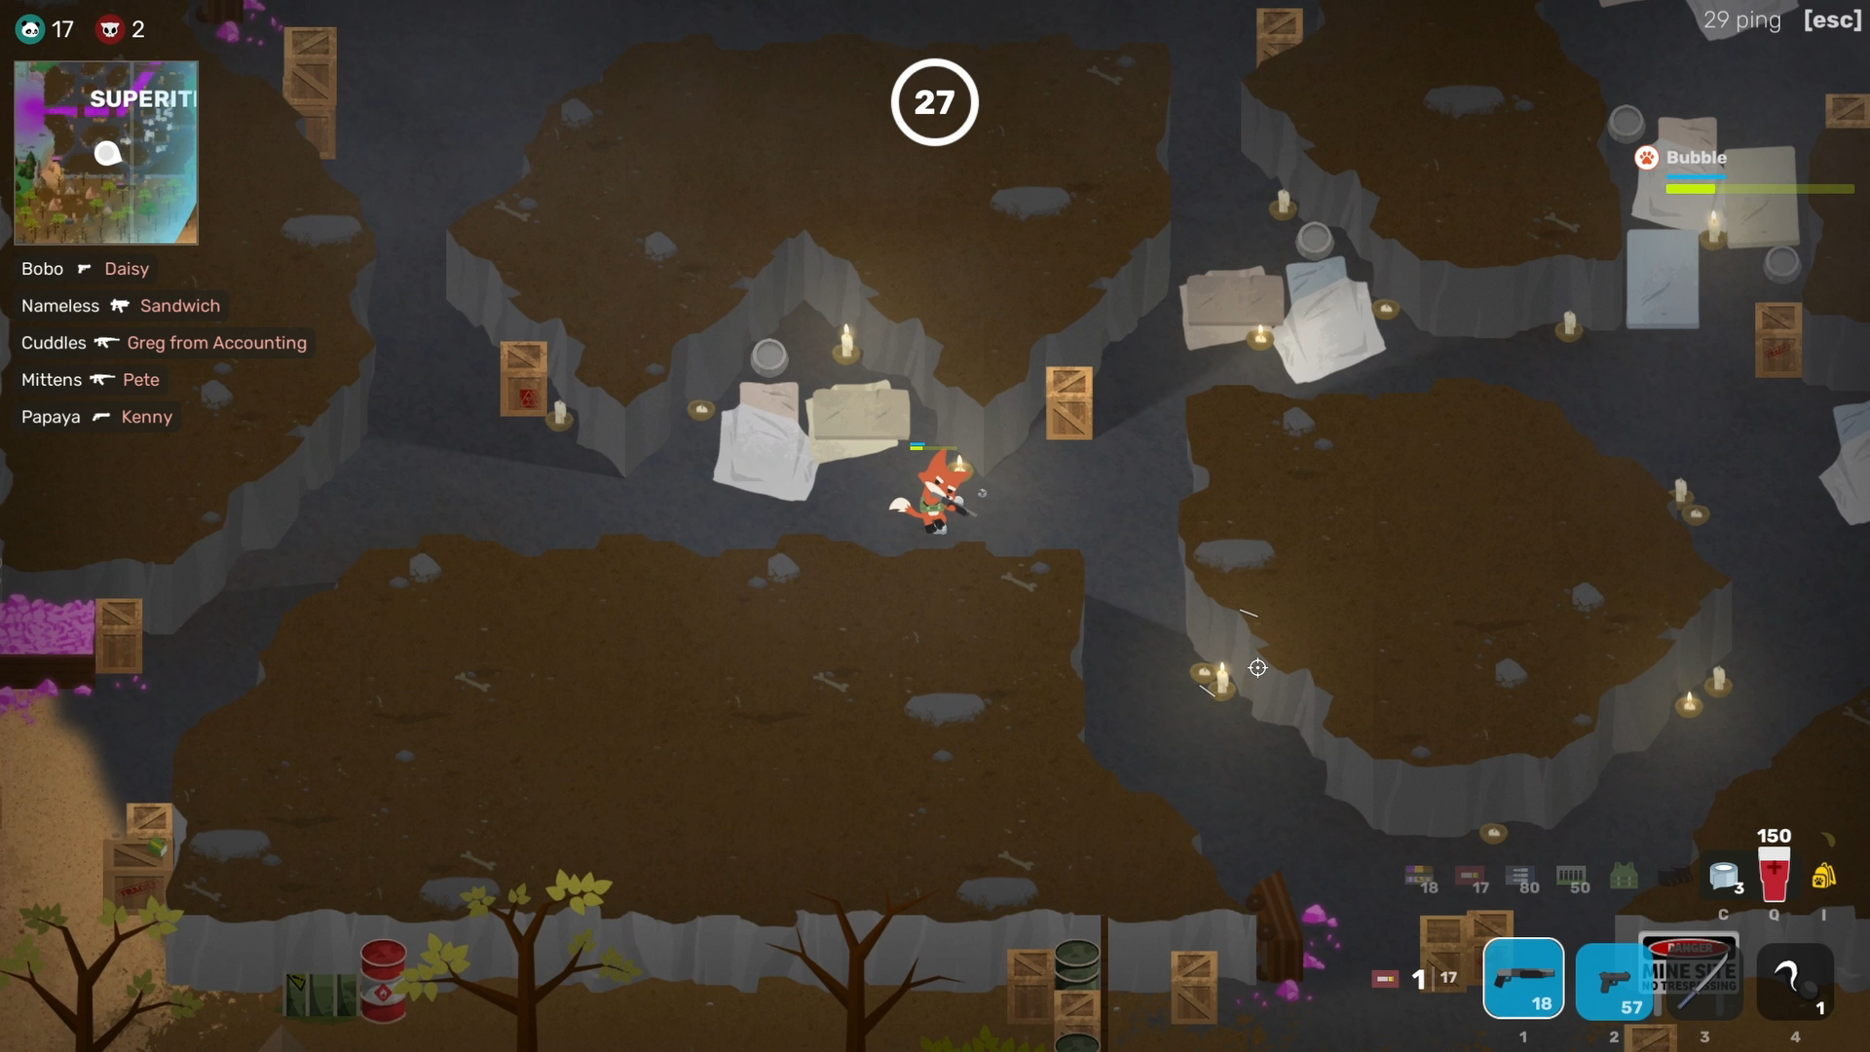
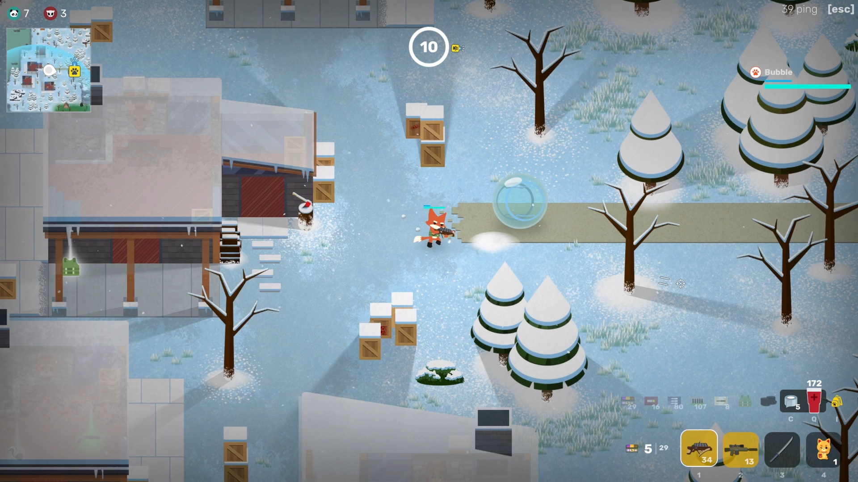

START
28426
677
Music Library
Character
Store
Music Library
Example 1
Gun
Example 2
+1 Damage
Fart
+2 Damage
Bubble
Double reload speed
Water
Larger ammo capacity
Cat
Bleed damage
Dog
5% stun chance
Gem
+10 all stats
Notes:
https://www.freepik.com/free-vector/tourist-with-backpack-map-stand-rocky-snowy-landscape-looking-route-traveler-man-lost-winter-mountains-travel-journey-explorer-extreme-hiking-adventure-cartoon-vector-illustration_23094435.htm#query=cartoon%20mountain&position=3&from_view=search&track=ais
https://www.flaticon.com/free-icons/settings https://www.flaticon.com/free-icons/gem https://www.flaticon.com/free-icons/coin https://www.freepik.com/free-vector/treasure-chest-bag-with-gem-stones-game-icons_35667619.htm#query=loot%20box&from_query=lootbox&position=3&from_view=search&track=sph

Slide 4
START
28426
677
Music Library
Character
Store
Music Library
Example 1
Gun
Example 2
+1 Damage
Fart
+2 Damage
Bubble
Double reload speed
Water
Larger ammo capacity
Cat
Bleed damage
Dog
5% stun chance
Gem
+10 all stats
Notes:
https://www.freepik.com/free-vector/tourist-with-backpack-map-stand-rocky-snowy-landscape-looking-route-traveler-man-lost-winter-mountains-travel-journey-explorer-extreme-hiking-adventure-cartoon-vector-illustration_23094435.htm#query=cartoon%20mountain&position=3&from_view=search&track=ais
https://www.flaticon.com/free-icons/settings https://www.flaticon.com/free-icons/gem https://www.flaticon.com/free-icons/coin https://www.freepik.com/free-vector/treasure-chest-bag-with-gem-stones-game-icons_35667619.htm#query=loot%20box&from_query=lootbox&position=3&from_view=search&track=sph

Slide 5
START
28426
677
Music Library
Character
Store
Music
Skins
Treasure
Gems
750
OR
55000
Bubble
Double reload speed
1000
OR
70000
Water
Larger ammo capacity
1250
OR
80000
Cat
Bleed damage
1250
OR
80000
Dog
5% stun chance
2500
OR
200000
Gem
+10 all stats
Notes:
https://www.freepik.com/free-vector/tourist-with-backpack-map-stand-rocky-snowy-landscape-looking-route-traveler-man-lost-winter-mountains-travel-journey-explorer-extreme-hiking-adventure-cartoon-vector-illustration_23094435.htm#query=cartoon%20mountain&position=3&from_view=search&track=ais
https://www.flaticon.com/free-icons/settings https://www.flaticon.com/free-icons/gem https://www.flaticon.com/free-icons/coin https://www.freepik.com/free-vector/treasure-chest-bag-with-gem-stones-game-icons_35667619.htm#query=loot%20box&from_query=lootbox&position=3&from_view=search&track=sph

Slide 6
START
28426
677
Music Library
Character
Store
Music
Sound tracks
Treasure
Gems
Sound tracks will be added soon! Come back later!
Notes:
https://www.freepik.com/free-vector/tourist-with-backpack-map-stand-rocky-snowy-landscape-looking-route-traveler-man-lost-winter-mountains-travel-journey-explorer-extreme-hiking-adventure-cartoon-vector-illustration_23094435.htm#query=cartoon%20mountain&position=3&from_view=search&track=ais
https://www.flaticon.com/free-icons/settings https://www.flaticon.com/free-icons/gem https://www.flaticon.com/free-icons/coin https://www.freepik.com/free-vector/treasure-chest-bag-with-gem-stones-game-icons_35667619.htm#query=loot%20box&from_query=lootbox&position=3&from_view=search&track=sph

Slide 7
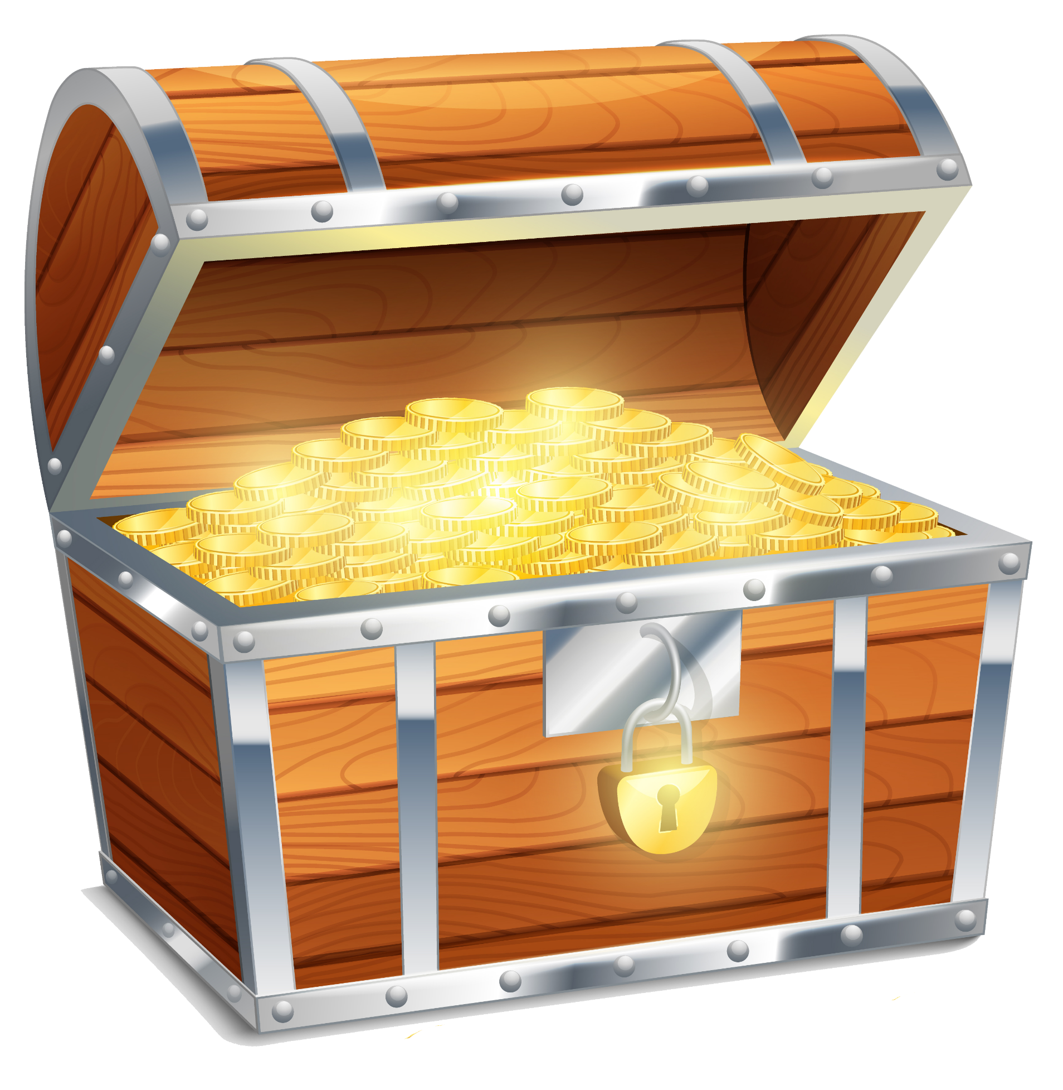
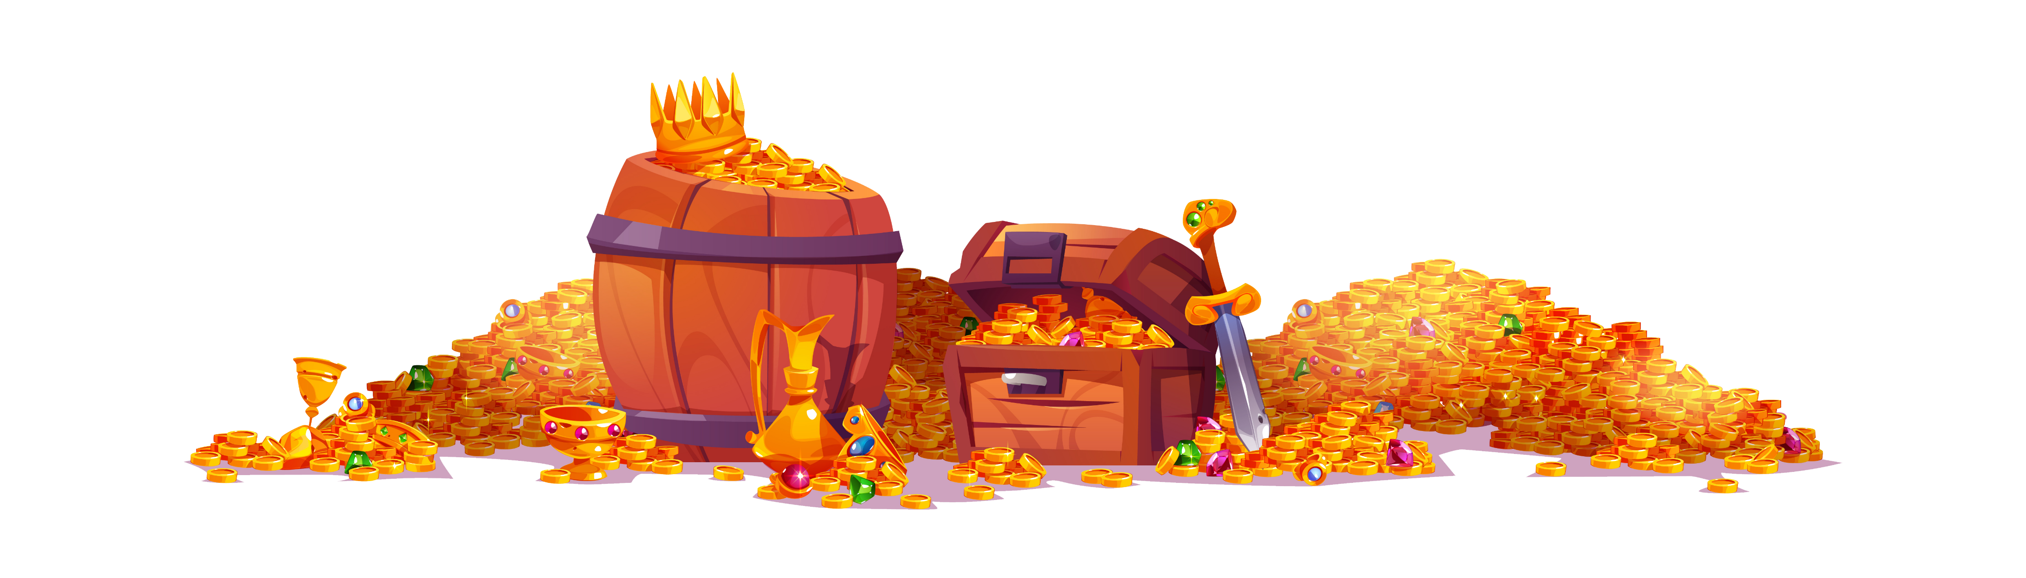
START
2842
677
Music Library
Character
Store
Music
Skins
Treasure
Gems
Possible rewards!!
Open for only 500
Bubble
Double reload speed
Click
10x 4000
Water
Larger ammo capacity
Cat
Bleed damage
Dog
5% stun chance
Gem
+10 all stats
Notes:
https://www.freepik.com/free-vector/tourist-with-backpack-map-stand-rocky-snowy-landscape-looking-route-traveler-man-lost-winter-mountains-travel-journey-explorer-extreme-hiking-adventure-cartoon-vector-illustration_23094435.htm#query=cartoon%20mountain&position=3&from_view=search&track=ais
https://www.flaticon.com/free-icons/settings https://www.flaticon.com/free-icons/gem https://www.flaticon.com/free-icons/coin https://www.freepik.com/free-vector/treasure-chest-bag-with-gem-stones-game-icons_35667619.htm#query=loot%20box&from_query=lootbox&position=3&from_view=search&track=sph https://www.freepik.com/free-vector/treasure-pirate-chest-gold-barrel-with-coins_33819268.htm#query=loot%20box&position=8&from_view=keyword&track=ais https://www.freepik.com/free-vector/realistic-old-style-pirate-treasure-chest_3949277.htm#query=loot%20box&position=33&from_view=keyword&track=ais

Slide 8
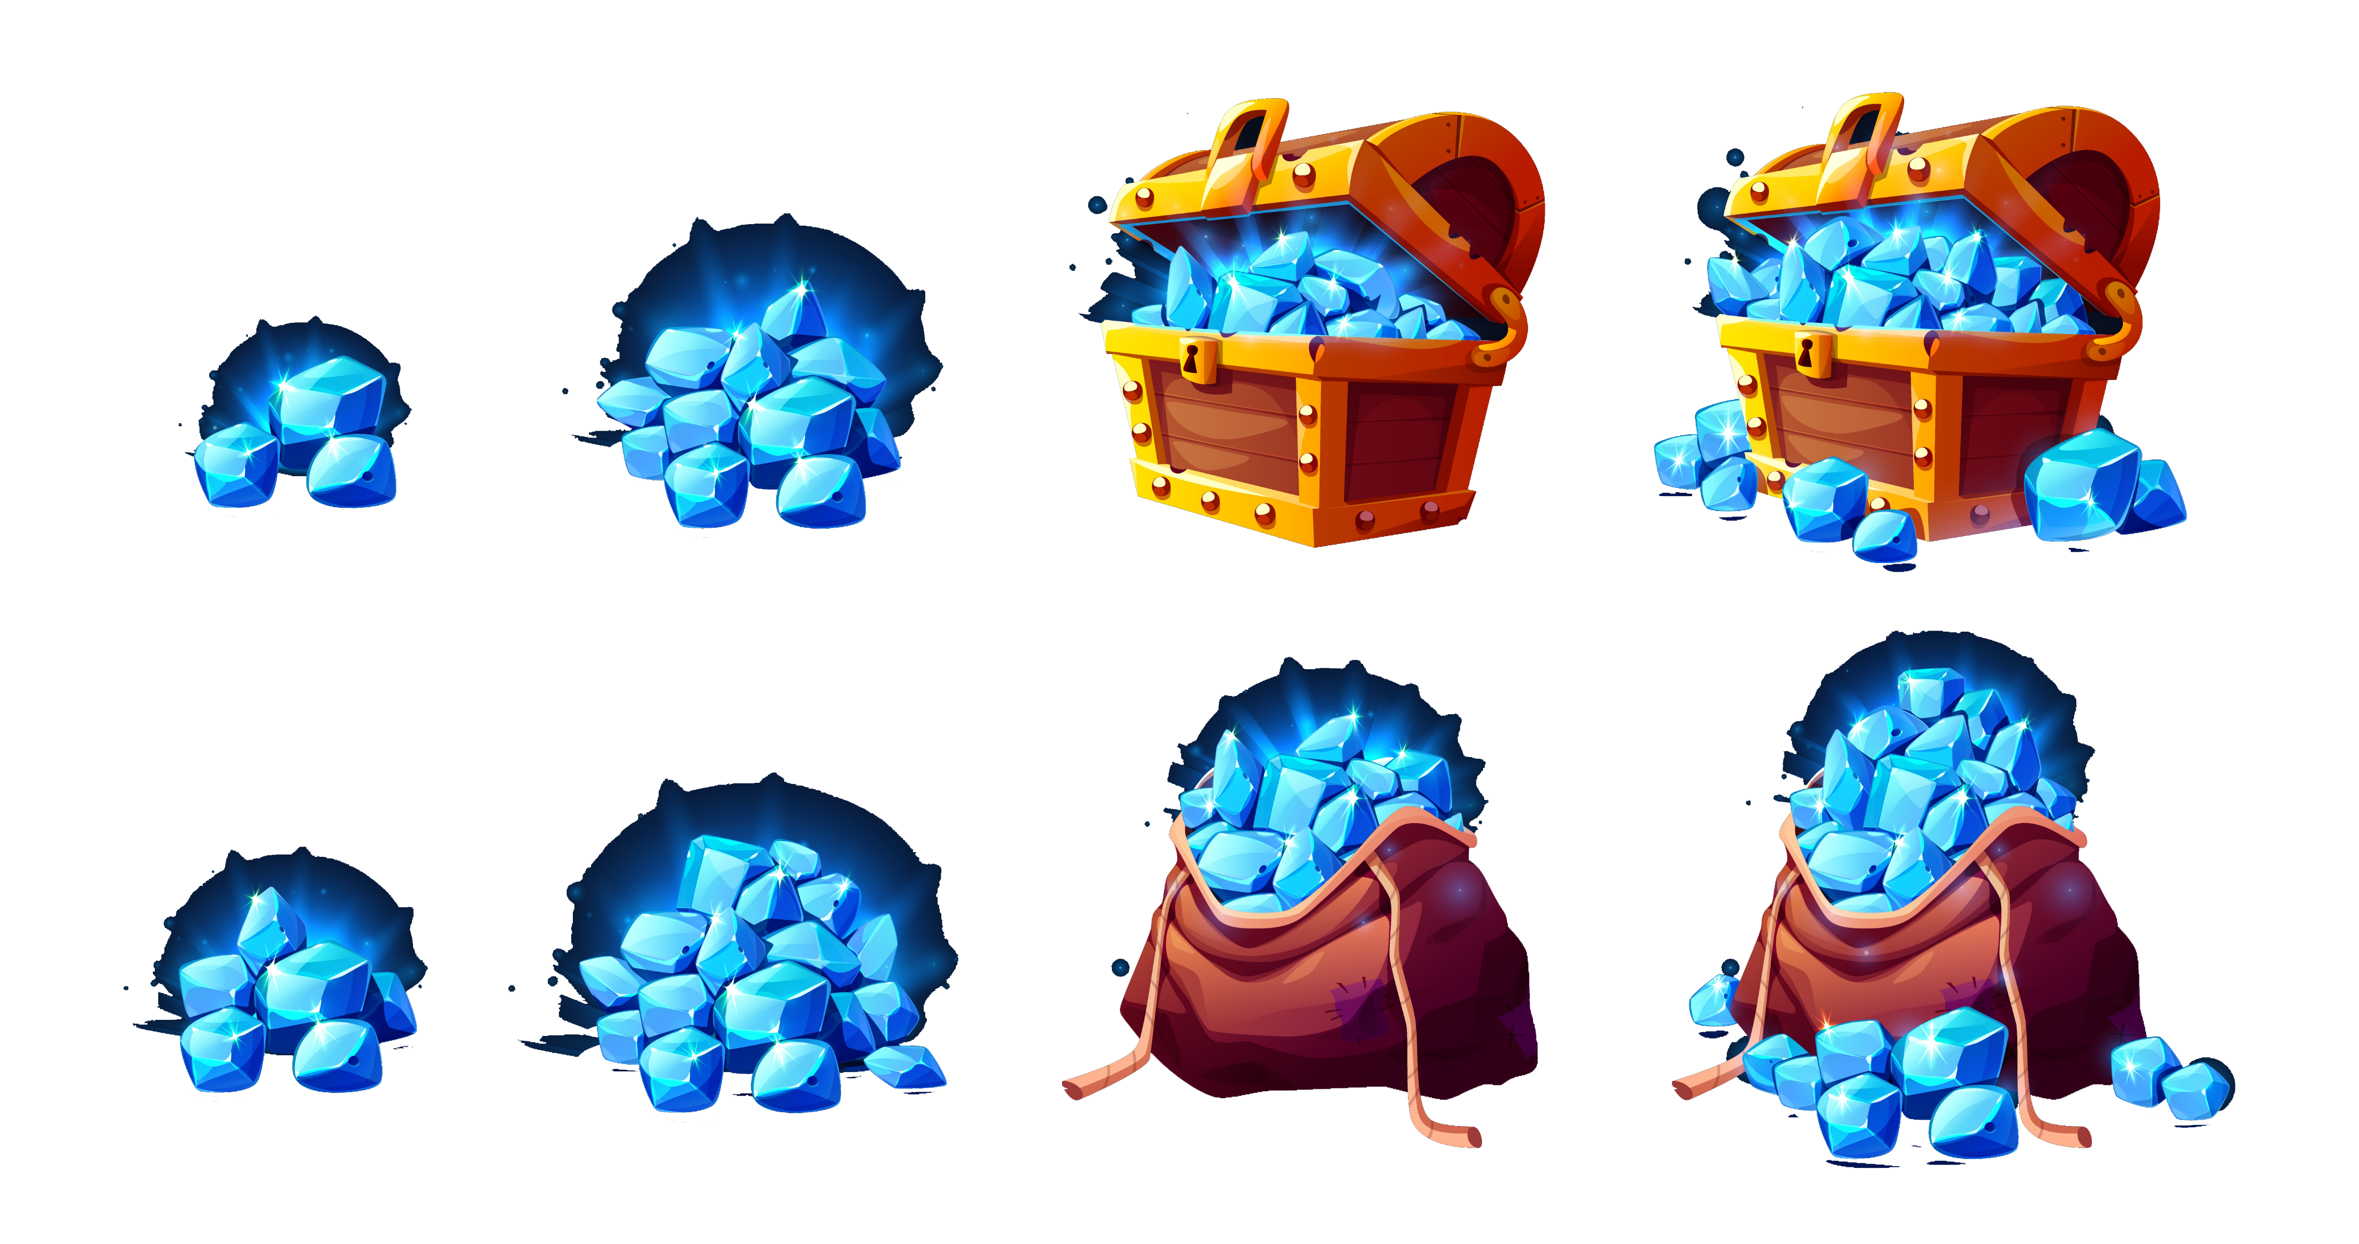
START
28426
677
Music Library
Character
Store
Music
Skins
Treasure
Gems
€1
100
€5
650
€65
15000
€100
30000
€2
250
€10
1500
€20
3250
€35
6500
Notes:
https://www.freepik.com/free-vector/tourist-with-backpack-map-stand-rocky-snowy-landscape-looking-route-traveler-man-lost-winter-mountains-travel-journey-explorer-extreme-hiking-adventure-cartoon-vector-illustration_23094435.htm#query=cartoon%20mountain&position=3&from_view=search&track=ais
https://www.flaticon.com/free-icons/settings https://www.flaticon.com/free-icons/gem https://www.flaticon.com/free-icons/coin https://www.freepik.com/free-vector/treasure-chest-bag-with-gem-stones-game-icons_35667619.htm#query=loot%20box&from_query=lootbox&position=3&from_view=search&track=sph

Slide 9
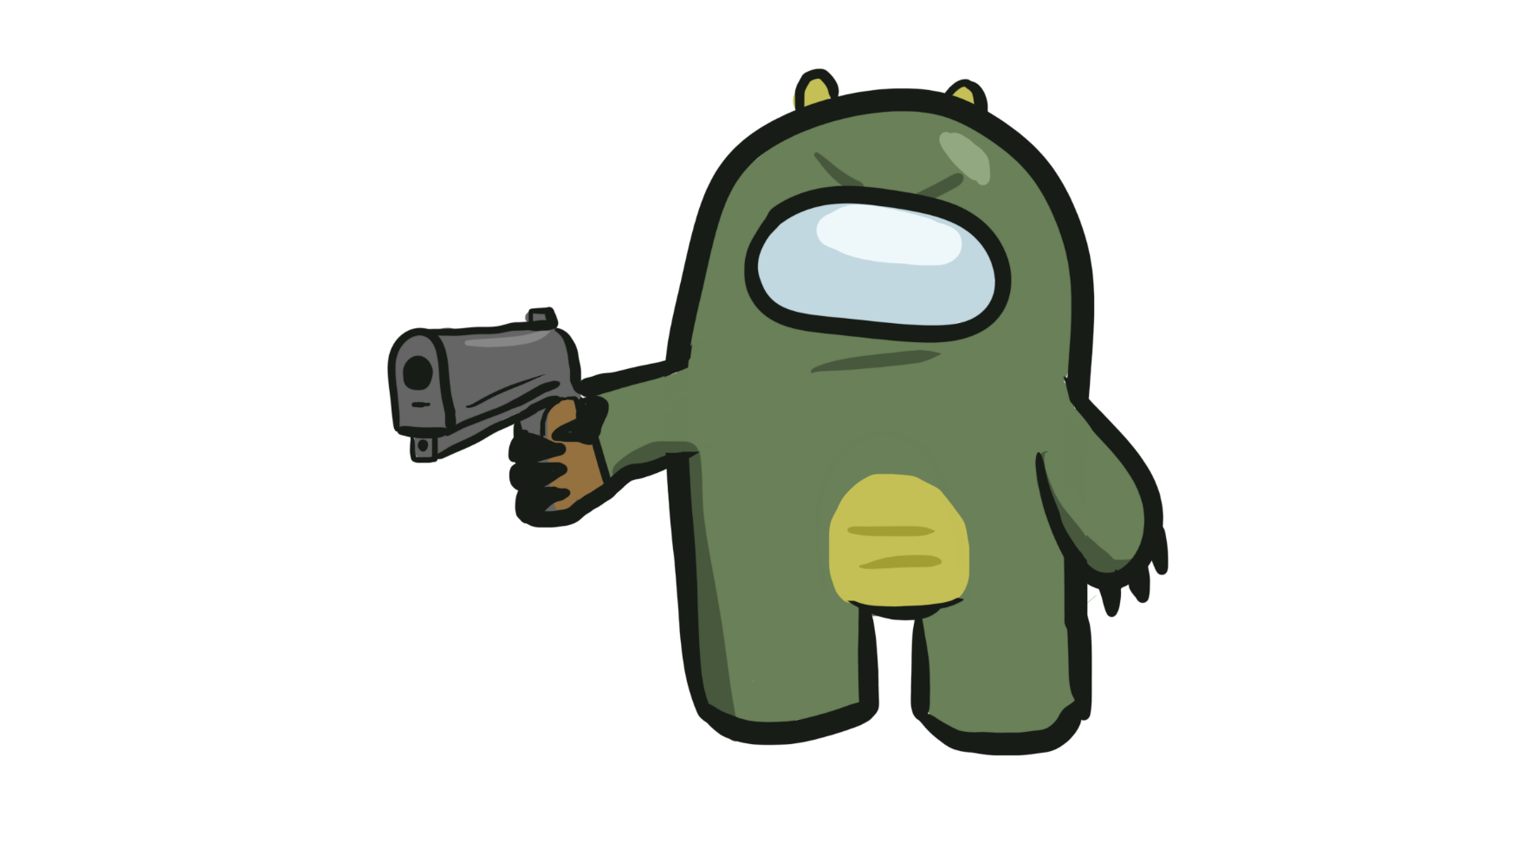
START
84926
1577
Music Library
Character
Store
Settings
This is a prototype in Power Point. There are no settings. Click the red cross and go back to the prototype. Thanks for testing :D
Enjoy Susbert
- Made by Nick
Notes:
https://www.freepik.com/free-vector/tourist-with-backpack-map-stand-rocky-snowy-landscape-looking-route-traveler-man-lost-winter-mountains-travel-journey-explorer-extreme-hiking-adventure-cartoon-vector-illustration_23094435.htm#query=cartoon%20mountain&position=3&from_view=search&track=ais
https://www.flaticon.com/free-icons/settings https://www.flaticon.com/free-icons/gem https://www.flaticon.com/free-icons/coin https://www.freepik.com/free-vector/treasure-chest-bag-with-gem-stones-game-icons_35667619.htm#query=loot%20box&from_query=lootbox&position=3&from_view=search&track=sph

Slide 10
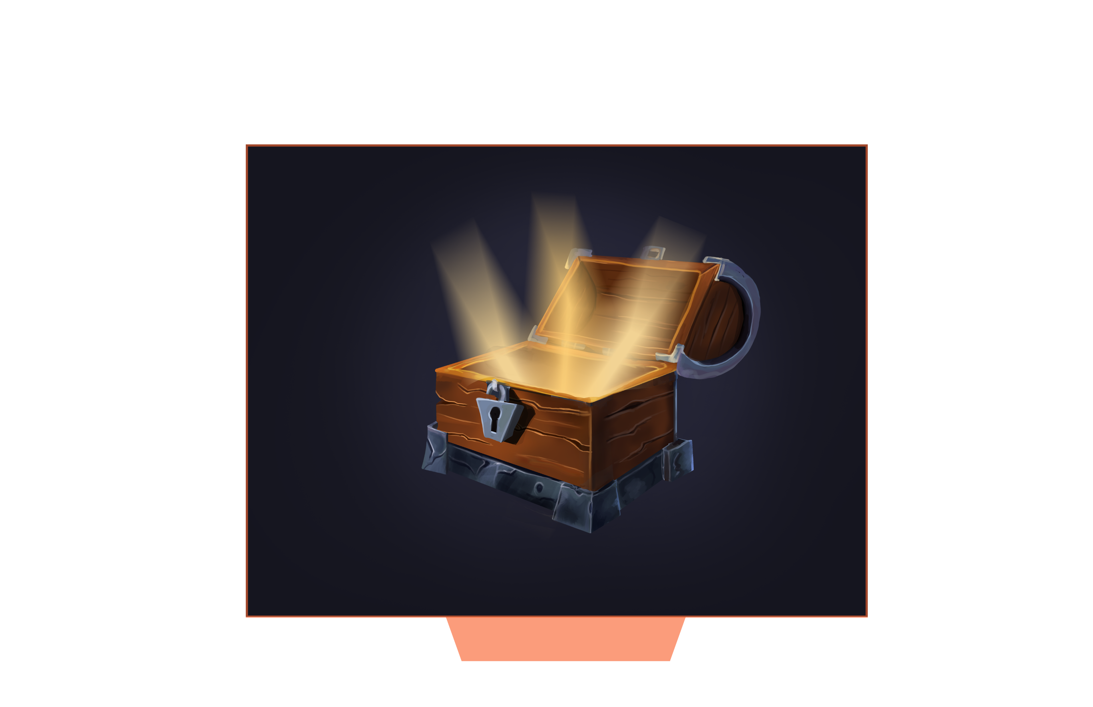
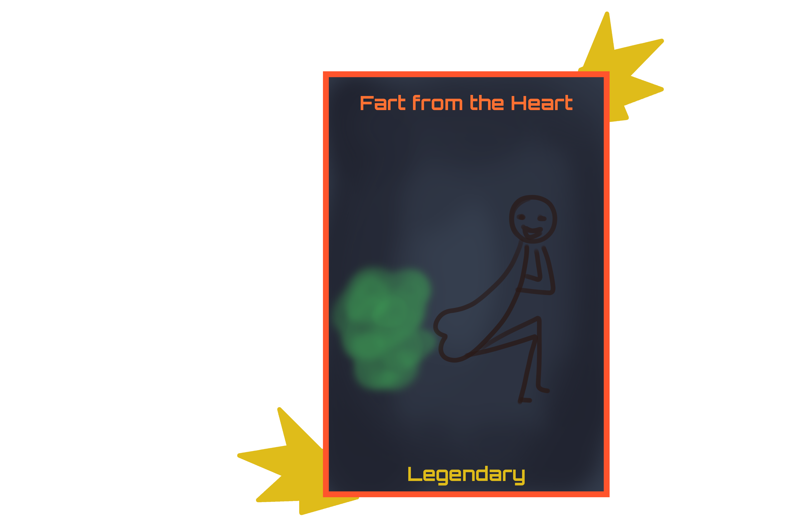
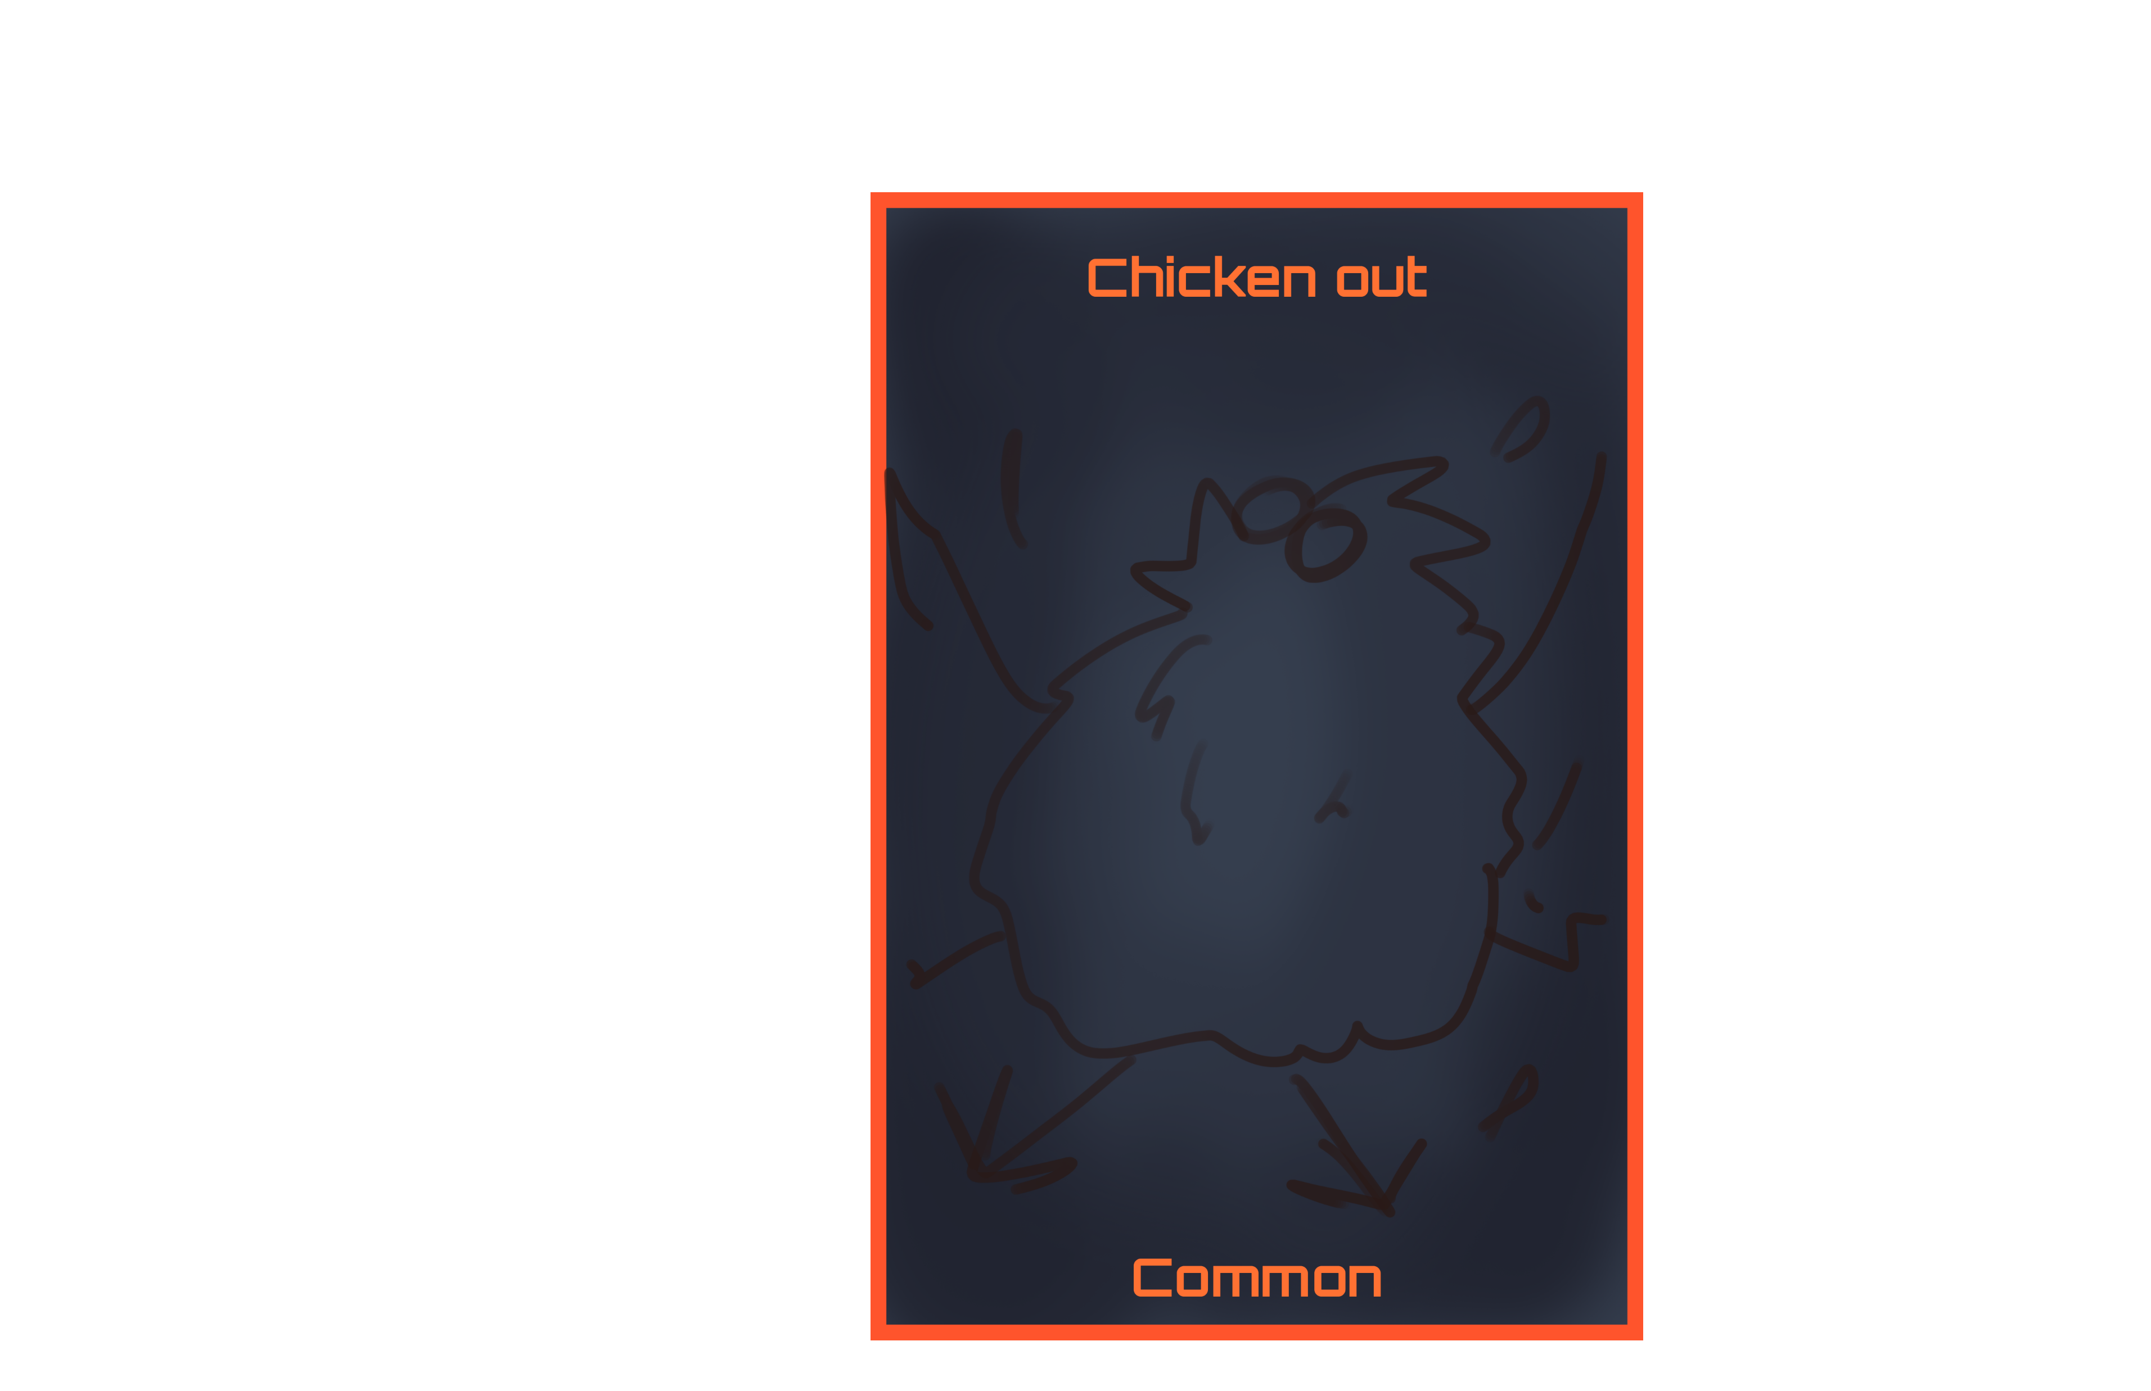
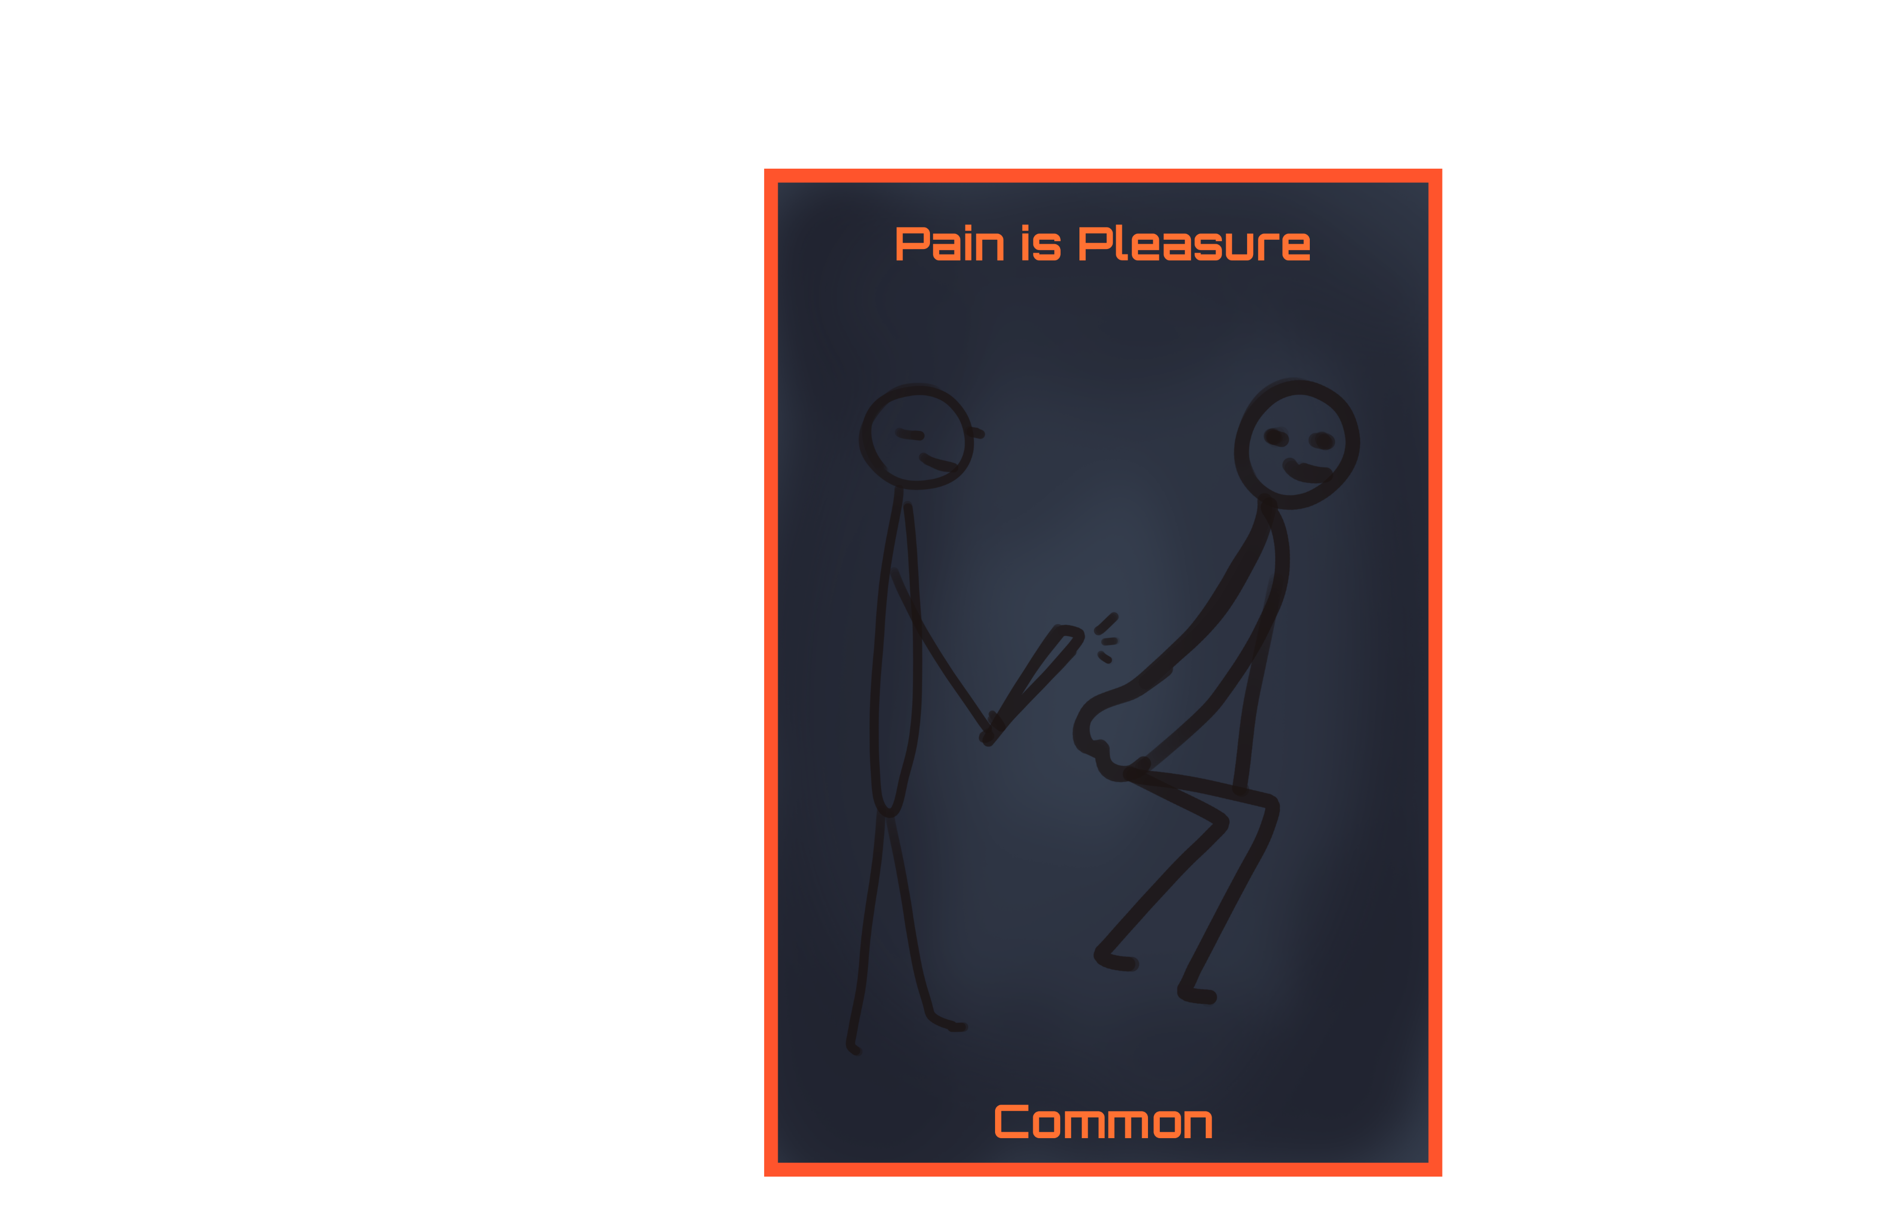
START
2842
677
Music Library
Character
Store
Music
Skins
Treasure
Gems
Possible rewards!!
Open for only 500
Bubble
Double reload speed
Click
10x 4000
Water
Larger ammo capacity
Cat
Bleed damage
Dog
5% stun chance
Gem
+10 all stats
Notes:
https://www.freepik.com/free-vector/tourist-with-backpack-map-stand-rocky-snowy-landscape-looking-route-traveler-man-lost-winter-mountains-travel-journey-explorer-extreme-hiking-adventure-cartoon-vector-illustration_23094435.htm#query=cartoon%20mountain&position=3&from_view=search&track=ais
https://www.flaticon.com/free-icons/settings https://www.flaticon.com/free-icons/gem https://www.flaticon.com/free-icons/coin https://www.freepik.com/free-vector/treasure-chest-bag-with-gem-stones-game-icons_35667619.htm#query=loot%20box&from_query=lootbox&position=3&from_view=search&track=sph https://www.freepik.com/free-vector/treasure-pirate-chest-gold-barrel-with-coins_33819268.htm#query=loot%20box&position=8&from_view=keyword&track=ais https://www.freepik.com/free-vector/realistic-old-style-pirate-treasure-chest_3949277.htm#query=loot%20box&position=33&from_view=keyword&track=ais

Slide 11
